Slide 1


Adversarial Attacks on MNIST
Exploring Extraction Attacks using ART Library
Presented by : Reem AL-ZOUHBY September 8, 2025
1

Slide 2

Plan
Explore the Etraction attack
A
CopyCat CNN
Knockoff Nets
B
C
Functionally Equivalent Extraction (FEE)
D
Explore the Demo APP!!
E

Slide 3
















Machine Learning (ML) Systems
(1) Gather labeled data
_{x}(1)_{, y}(1) _{x}(2)_{, y}(2)
…
Bob Tim
Data
Jake
n-dimensional feature vector x
Dependent variable y
Training
(2) Train ML model f from data
f ( x ) = y
Model f
Prediction
Confidence
Bob
x =
y =
Ti
m
Jake
(3) Use f in some application or publish it for others to use
Application
Usenix Security’16

Slide 4
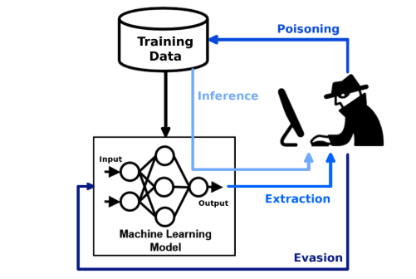

Evasion Attacks

Slide 5











Model Extraction Attacks
Target: f(x) = f’(x) on ≥ 99.9% of inputs
Attack
x
f(x)
Model f
Data
f’
Usenix Security’16

Slide 6
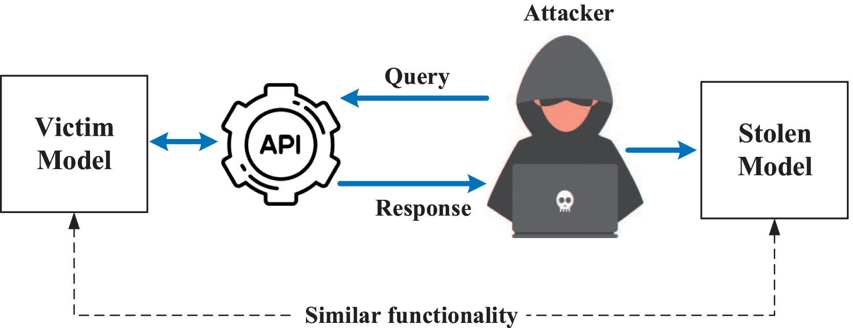

Slide 7
Why should we care?
Intellectual Property Theft - Stealing months/years of research and development
Economic Impact - Competitors can replicate expensive models cheaply
Privacy Risks - Extracted models may leak training data information
Stepping Stone Attacks - Stolen models enable further adversarial attacks

Slide 8
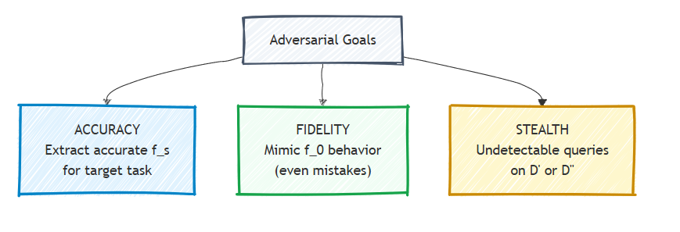
Notes:
What's the attacker trying to do?"

Slide 9
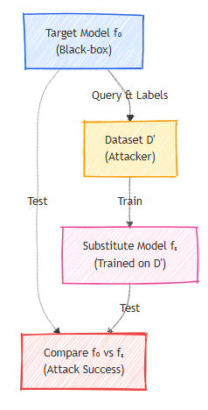
Threat Model
Notes:
How they achieve those goal??

Slide 10
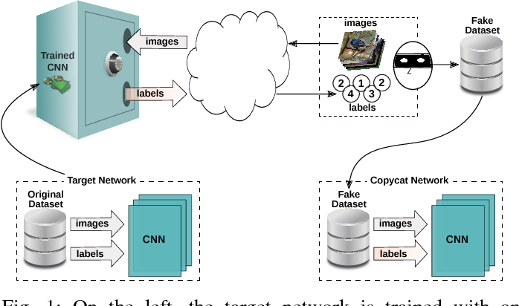
Copycat CNN
Second Step
?
First Step

Slide 11
How we do it??
Collect substitute dataset (different from original training data)
Query target model with substitute data to get predictions
Train substitute CNN on (data, prediction) pairs
Evaluate stolen model accuracy on target task

Slide 12
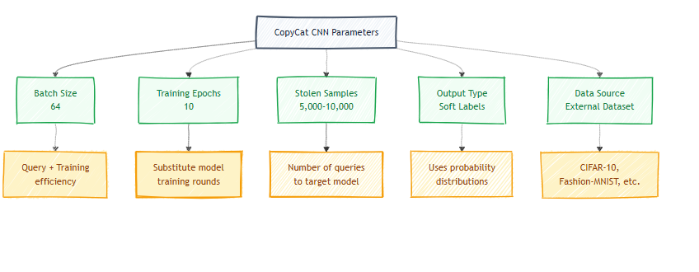

Slide 13
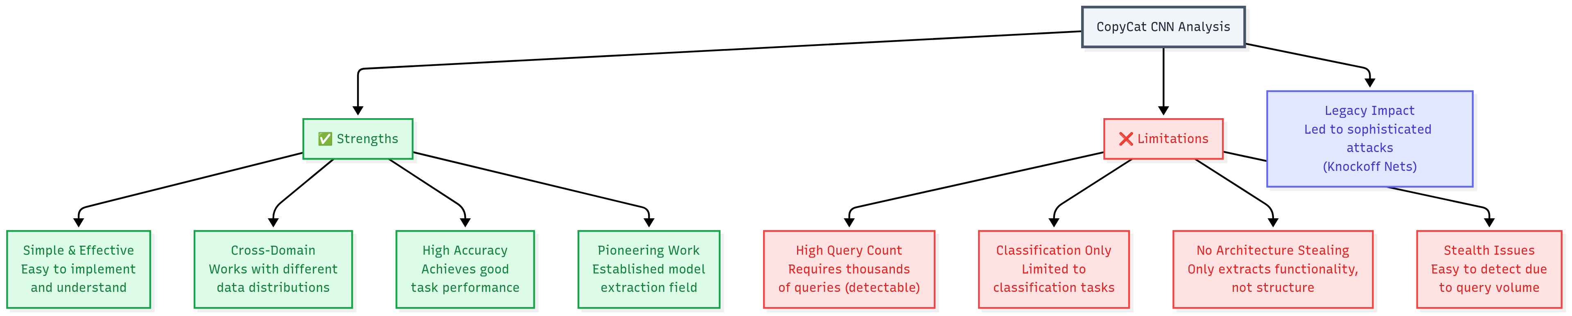

Slide 14
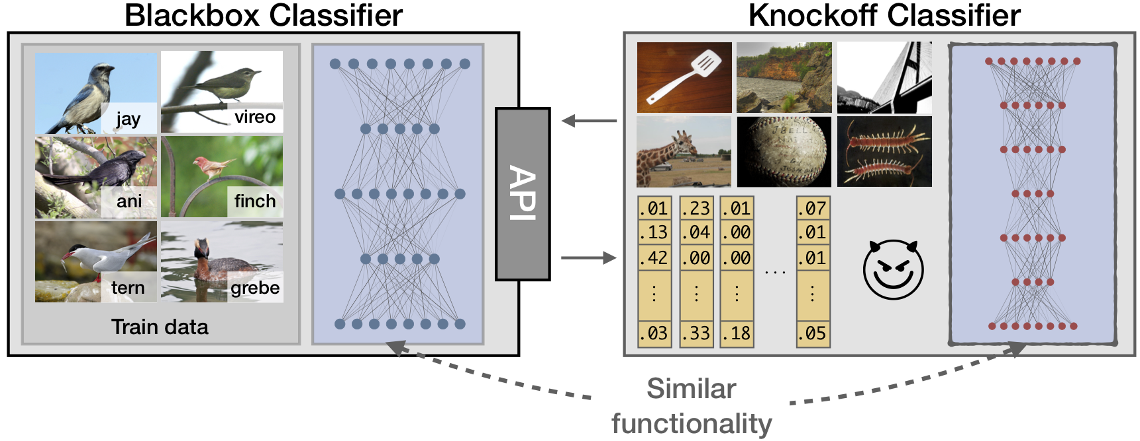
Knockoff Nets

Slide 15
Why Knockoff Nets > CopyCat CNN?
Many queries
Fewer queries
Random sampling
Adaptive sampling
Easy to detect
Harder to detect
Fixed strategy
Dynamic strategy

Slide 16
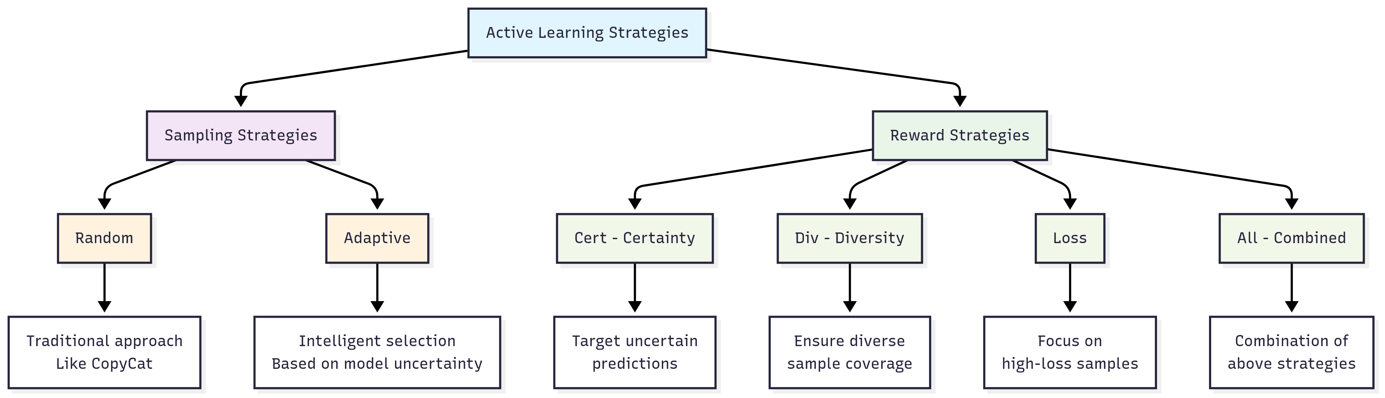
Knockoff Nets: Smart Query Selection

Slide 17
Functionally Equivalent Extraction (FEE)
FEE Approach
Different architecture
Mathematical reconstruction
Perfect equivalence
100% identical outputs

Slide 18
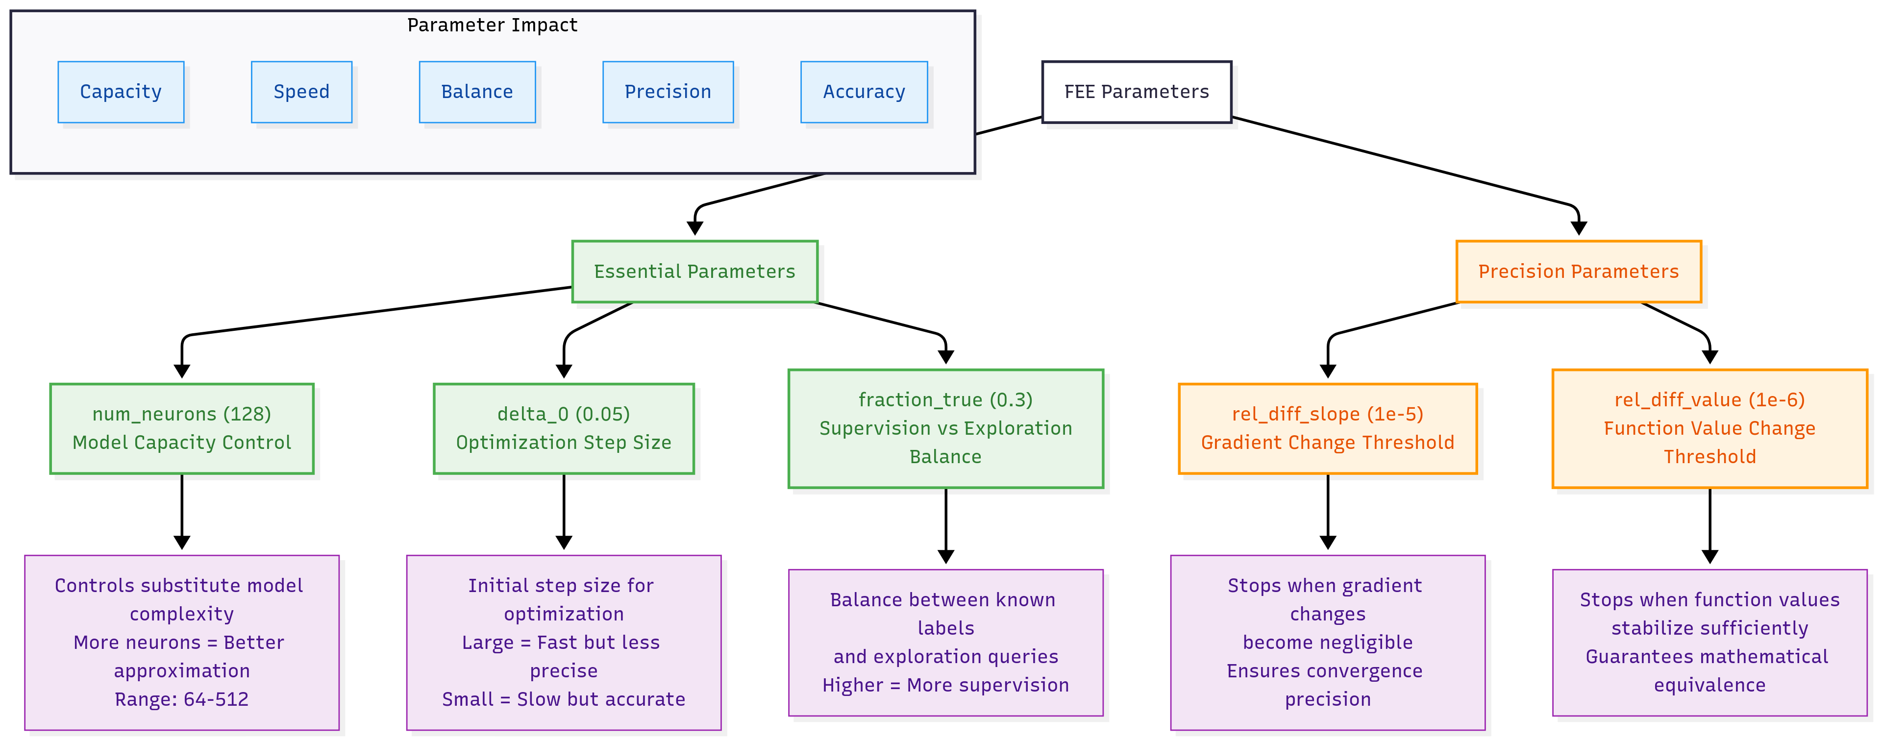

Slide 19
